Slide 1
Capstone Project
Airbnb Bookings Analysis

Slide 2


Slide 3
Table of Content
About Airbnb
About Agenda
Data Description
Preprocessing
Exploratory Data Analysis
Challenges
Conclusion
Tools Use

Slide 4


About Airbnb
Airbnb, Inc. is an American company that operates an online marketplace for lodging, primarily homestays for vacation rentals, and tourism activities. Based in San Francisco, California, the platform is accessible via website and mobile app. Airbnb does not own any of the listed properties; instead, it profits by receiving commission from each booking. The company was founded in 2008 by Brian Chesky, Nathan Blecharczyk and Joe Gebbia. Airbnb is a shortened version of its original name, AirBedandBreakfast.com.

Slide 5
Agenda
We will analyse the Airbnb dataset of New York City.
We will perform different analysis and try to gain insights like:
Which borough has more number of listings and the reason behind it.
The neighbourhood that is more popular
Room types that are preferred the most by guests
Review and ratings
By doing this we will try to find the factors affecting the Airbnb listings in New York City.

Slide 6
Data Description id :- These give us the listing id name:- Listing name host_id:- host id host_name :- host name neighbourhood_group :- NYC borough neighbourhood:- NYC neighbourhood latitude :- listing latitude longitude :- listing longitude room_type :- type of room ( entire home / apt , private room ,share room) price:- listing price minimum_nights:- minimum nights people stay number_of_reviews:- total number of reviews

Slide 7
last_review:- Date of last reviews reviews_per_month :- Average number of reviews per month calculated_host_listings_count:- Total number of listing for this host availability_365:- Number of days listing available

Slide 8
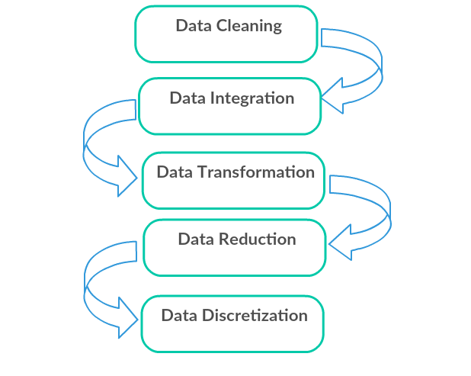
Preprocessing
Cleaning of dataset is very important to get a relevant Information out of it. Following are the process that we have followed to clean our data:
We have determined the shape, columns and their data types of our dataset.
Eliminated the columns that are not needed in our analysis.
Determined the columns that have null values present in it and the null
Count.
Imputed the null values that has higher number of null count.
Deleted the records for the columns that has very low null count.

Slide 9
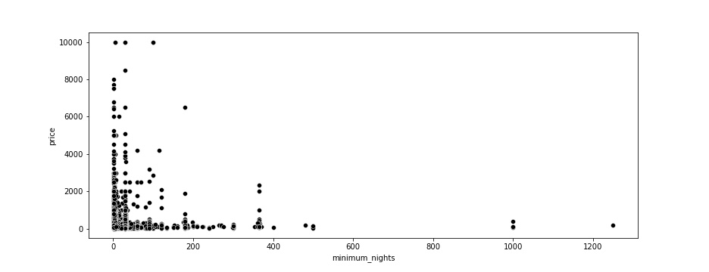
Exploratory Analysis
The famous price vs minimum nights
We will be finding the relationship between these two numerical variables using seaborn scatter plot as show
Many data point are clustered on 0 price range , few have min nights for stay but price is 0 , look like anamoly in price

Slide 10
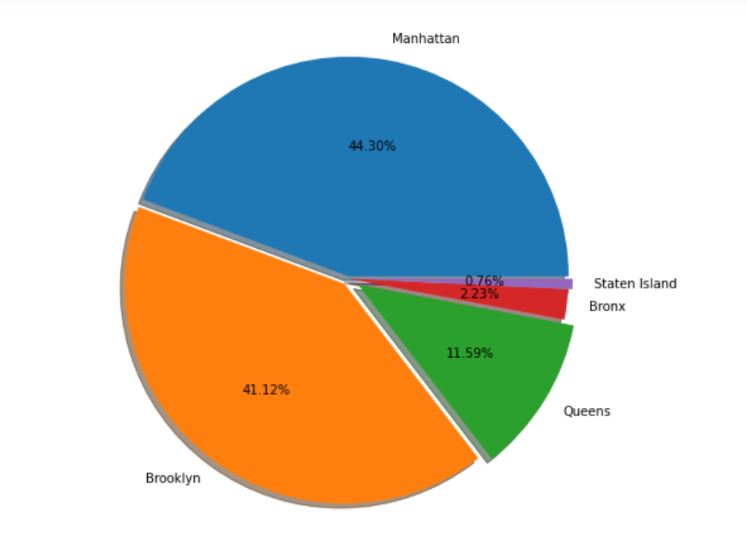
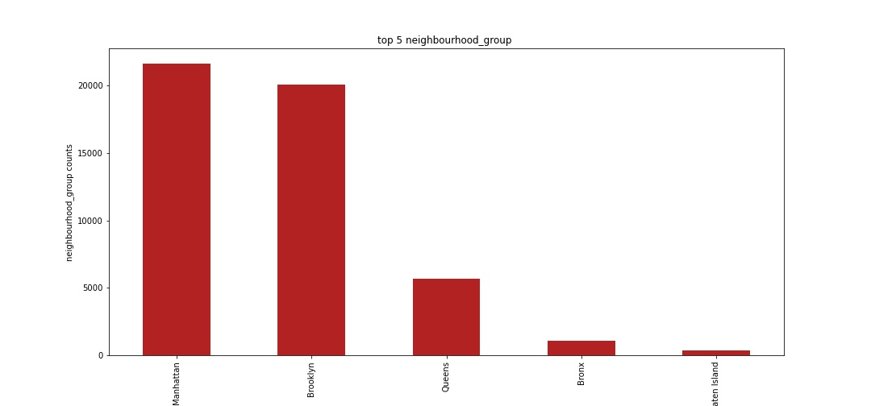
Top 10 Neighbourhood groups
From this graph we infer that Manhattan has the maximum number of airbnbs in the whole of NYC .
We can clearly see that group Manhattan has 44.3% of listing and followed by Brooklyn has 41.2%
Staten island has very less number listing about 0.7%

Slide 11
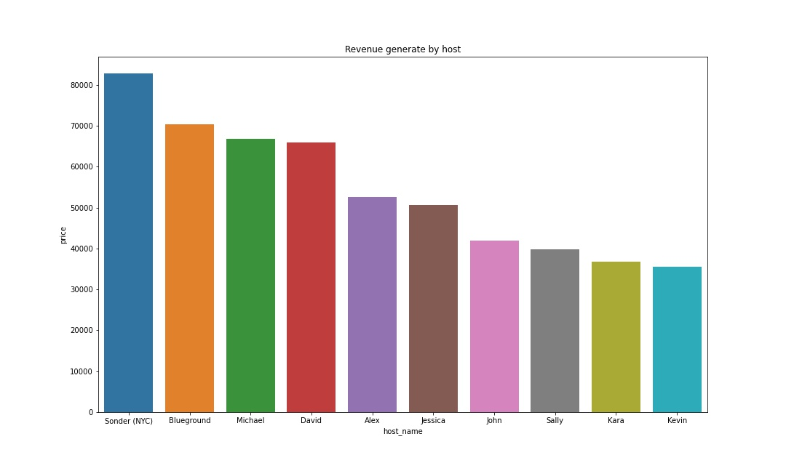
host name vs price
As per the above observation we can see Sender(NYC) has most expensive host followed by Blueground

Slide 12
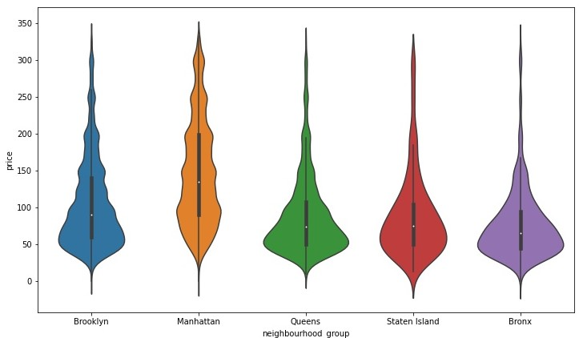
Most costlier place
Below is violinplot plot showing the five point summary of listing prices according to the different boroughs present. We have following observations from the plot:
Manhattan is the costliest among all the boroughs.
Bronx is the cheapest among all the boroughs.
The rest of the three boroughs namely, Brooklyn, Staten Island and Queens has more or less same price.

Slide 13
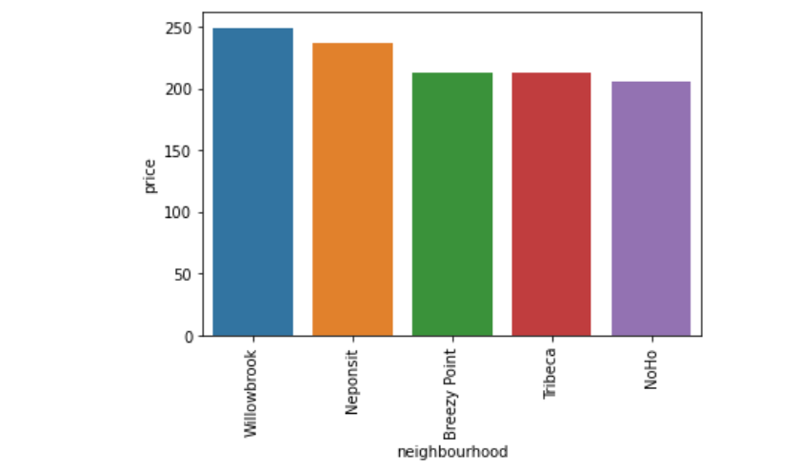
neighbourhood
Among the top neighbourhood in each neighbourhood groups, top 2 of them namely: Fort Wadsworth & Neponsit

Slide 14
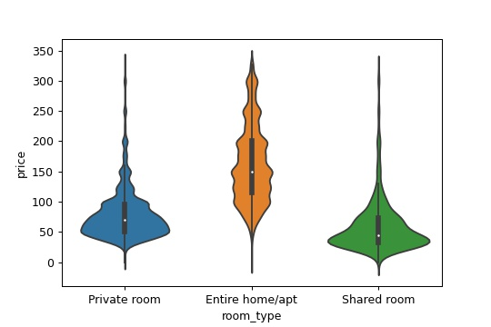
Room _type with price
Entire home may averagely cost 150 USD .
Private room average cost is nearly 75 USD
Share room least cost price is less than 50 USD
So lets check which type of rooms guest be prefer to leave in with review counts

Slide 15
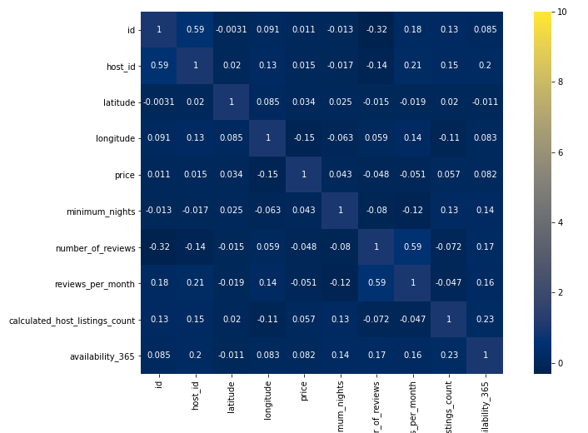
Correlation Heatmap
There is a negative correlation between host_id and number_of reviews so we can say for a region where there are more number of hosts, the guests will have more option of booking that are available which will ultimately divides the number of reviews or, if the particular host have multiple Airbnb listings then he will have a lot to manage already, so he does not take proper reviews from their guests.
There is a negative correlation between longitude and price and mild positive correlation between latitude and price, so we can say that the areas towards north-west are more costly
There is a negative correlation between longitude and calculated_host_listings_count , depicts that areas towards west have more Airbnb listings.
price and number_of_reviews are negatively correlated to each other as lesser number of people will prefer the costly aboard
number_of_reviews and reviews_per_month have negative correlation with minimum_nights, we can conclude that guest prefers flexibility of check-out

Slide 16
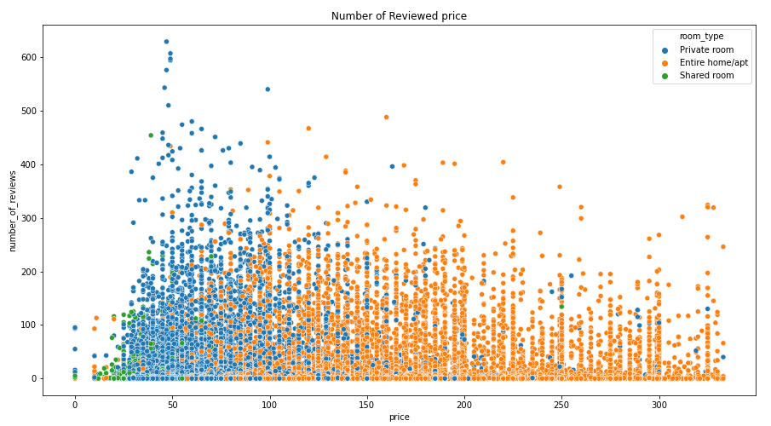
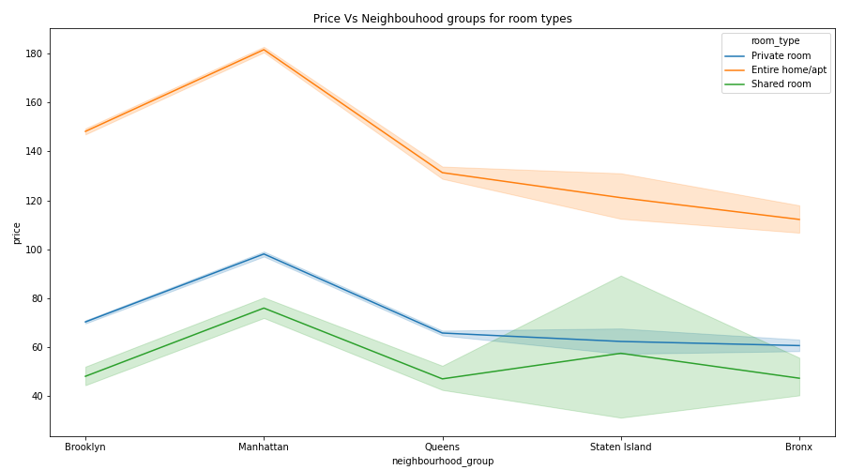
Price Vs Locations and Number of reviews
Fig1. shows the variation of number of reviews and price of different rooms types
Private rooms are getting more number of reviews as compared to other two categories, it may be due to the private room types are less costly so more people can afford it
Fig 1 no_of_reviews vs price
Fig 2 no_of_reviews vs price
Fig 2. shows the variation of price by locations of room types.
The listing offering Entire home/apt are generally costly than the other two. And from earlier graphs we have seen that Manhattan is the costliest, has maximum number of Entire home/apt and receiving lesser reviews which is valid.

Slide 17
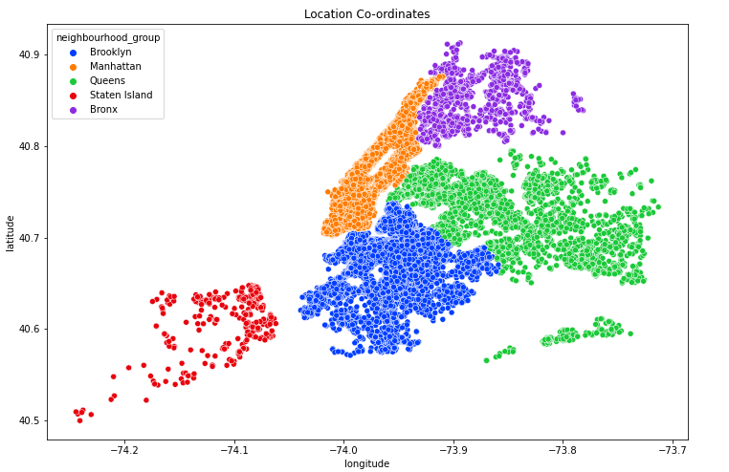
From the above two charts we can observe that Manhattan has the highest traffic among all five neighbourhood groups. Manhattan has more traffic probably because it is the most popular borough of NYC and considered to have most of very popular attractions. In fact, most people believe Manhattan to be the synonym of NYC. Brooklyn comes second on the basis of traffic as it is considered to be the second most famous district of New York after Manhattan. Staten island has least because this location is least known.

Slide 18
By exploring the Airbnb dataset we have drawn many out many information. Some of them are listed below:
Our Airbnb dataset has data from the five boroughs of NYC namely Manhattan, Brooklyn, Queens, Bronx and Staten Island
Manhattan has maximum number of listings, this may be the case because Manhattan has almost 99% of tourists attractions all over the NYC. Some of them are Empire State Building, the Rockefeller Center, the surprising Chrysler Building, the fascinating Times Square, the controversial MoMA etc.
Brooklyn has second highest listings and Staten Island has the least.
Most of the hosts from Manhattan has multiple number of listings.
Most of the guests visiting Manhattan and Brooklyn are not giving reviews, it may be because more corporate bookings are happening in Manhattan and Brooklyn or the high profile people are visiting these locations, and they probably do not give reviews most often.
The boroughs with less number of listings are receiving more reviews, the reason probably would be the hosts are able to cater to most of their guests and encouraging them to give reviews.
There are three categories of room types available which are: Entire home/apt, Private Rooms and Shared rooms. Out of these three Entire home/apt is very expensive and shared rooms are the least expensive.
Private rooms are mostly preferred over Entire home/apt because it is less costly and has less minimum nights dependency.

Slide 19
Tools Used
Jupyter Notebook
Python
Github
Libraries imported:
Pandas
Numpy
Matplotlib
Seaborn

